Slide 1
Bayesian Integration
(MCMC I)
Fish 558; Day 4: 08h30-10h00

Slide 2


Objectives for MCMC
MCMC is a way to construct a (joint) Bayesian posterior for the parameters of a model by generating samples from the posterior.
The basic idea is to set up a (long) “chain” which starts at a pre-specified parameter vector and then traverses the posterior distribution, i.e.: we want a sequence of parameter vectors, , which converges to the posterior distribution .
The sample from the posterior distribution is then every n’th element in the chain (ignoring the first “few” elements of the chain).

Slide 3
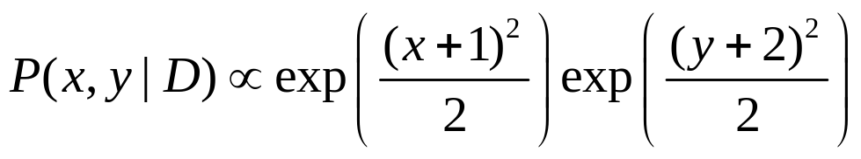
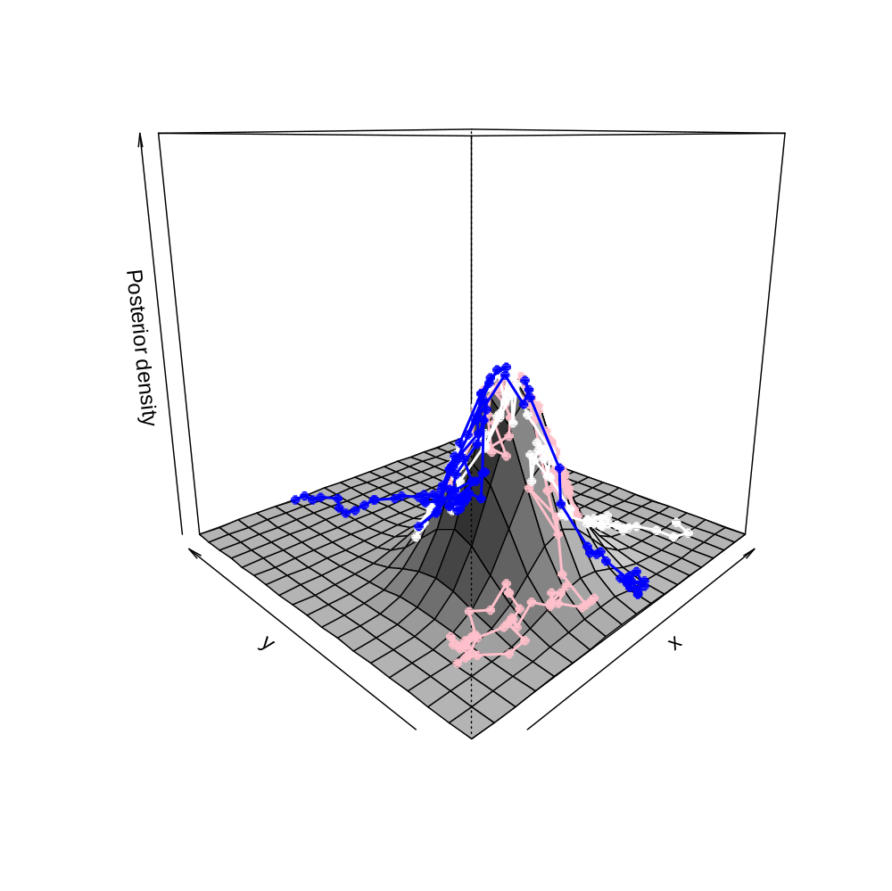
Starting vector
First “few” points

Slide 4
Overview of the MCMC algorithm
Select an “initial” parameter vector (often the mode of the posterior) and compute its posterior density (the product of the likelihood and the prior).
Generate a “new” parameter vector based on the current one (using a “jump” function) and compute its posterior density.
Replace the current parameter vector by the new parameter vector:
  if the posterior density of the new parameter vector is larger than that of the current parameter vector; or
  with probability equal to the ratio of the new to the current posterior density if the posterior density of the new parameter vector is less than that of the current parameter vector.
Output the current parameter vector.
Repeat steps 2)- 4) many times!
Steps 2-4 are referred to as a cycle.

Slide 5
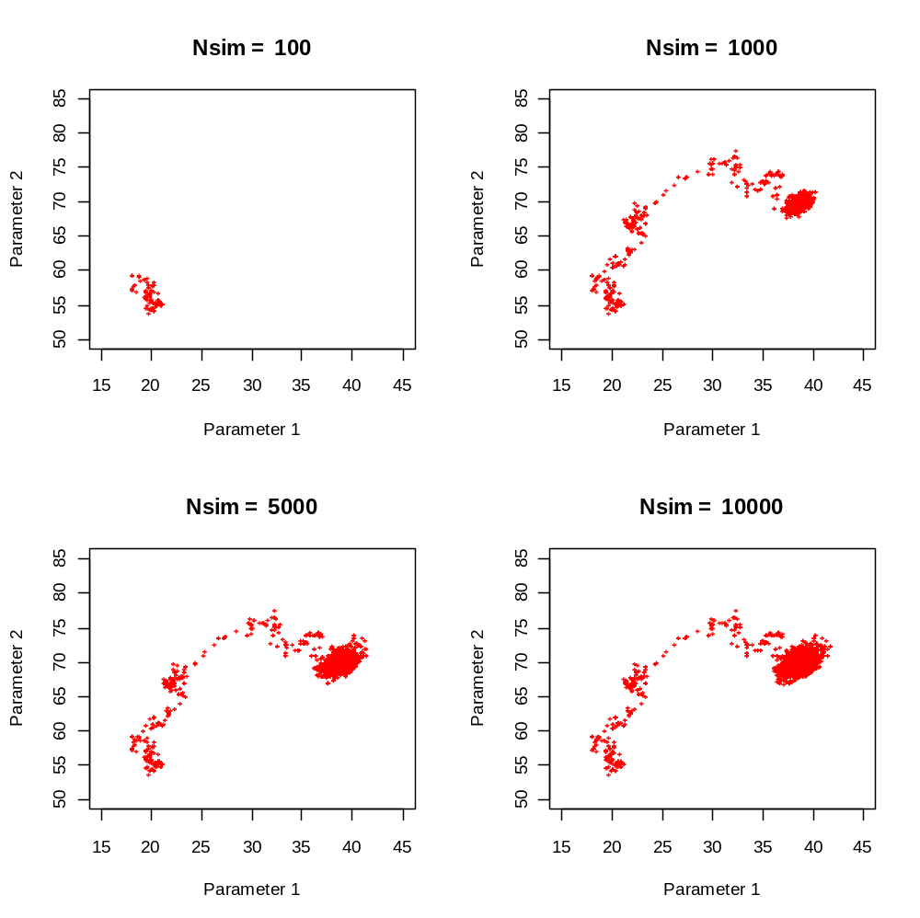
Impact of increasing
the number of cycles

Slide 6
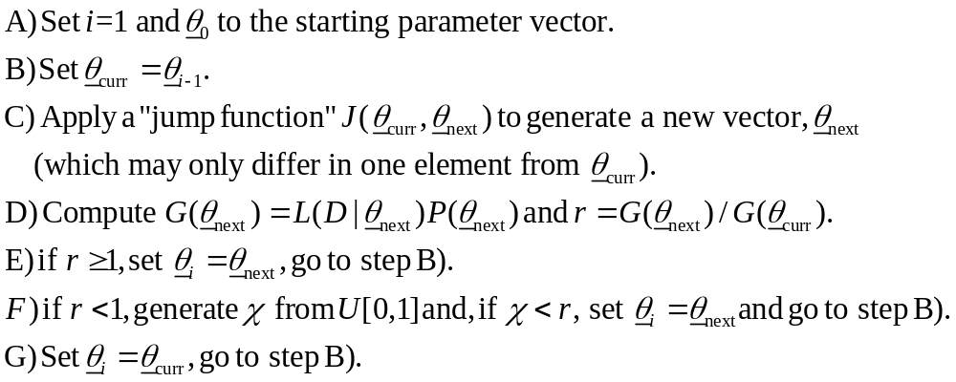
A Little More Detail

Slide 7
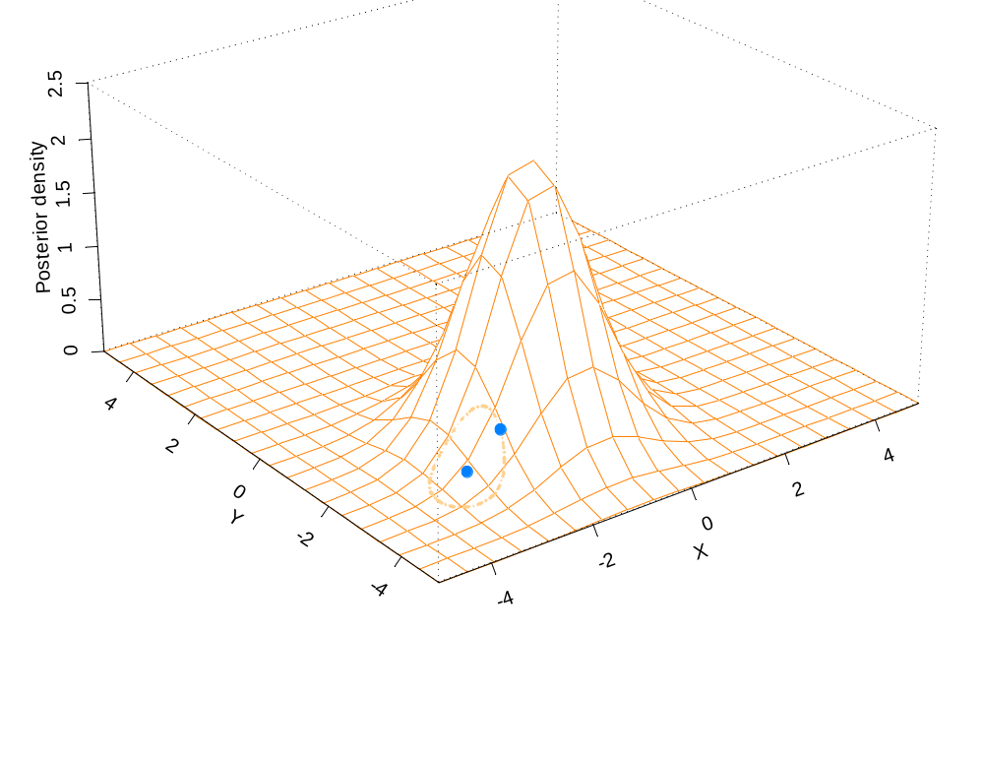
And Graphically-I
r=2.49;
Accept the new point.

Slide 8
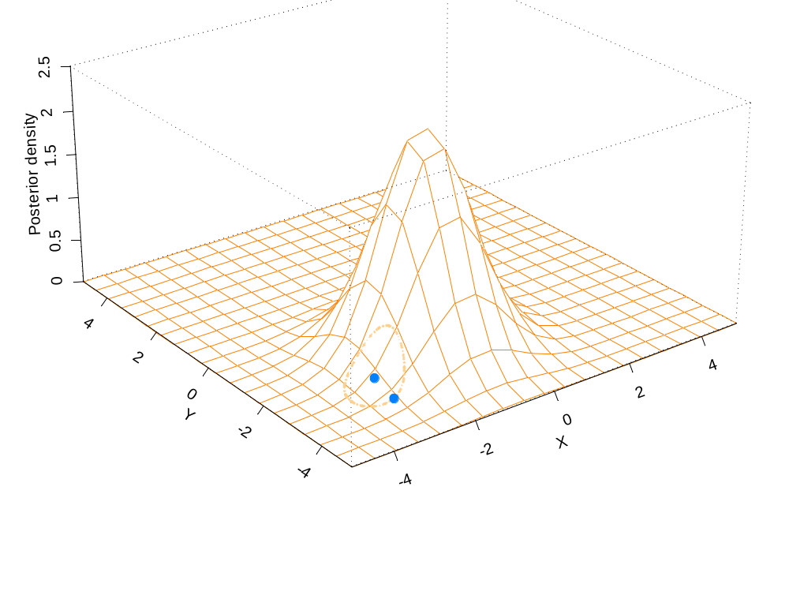
And Graphically-II
r=0.5;
Accept the new point
with probability 0.5

Slide 9
The Jump Function-I
The “jump” function should be chosen to optimize performance (but is usually selected for computational convenience).
It should be possible to reach all possible parameter vectors “eventually” by applying the “jump” function long enough.
We only consider symmetric “jump” functions (the probability of jumping from parameter vector x to parameter vector y is the same as that of jumping from parameter vector y to parameter vector x) – versions of MCMC exist for non-symmetric “jump” functions.

Slide 10
The Jump Function-II
Examples of jump functions:
  Univariate jump functions (e.g. add a uniform random number to each element of the current parameter vector).
  Multivariate jump functions (e.g. a multivariate normal or t centred at the current parameter vector). Note that:
    All the parameters are updated simultaneously.
    The ADMB “jump” function is a multivariate normal. The variance-covariance matrix is a rescaled version of that which is generated by ADMB.

Slide 11
The Jump Function-III
The Jump Function can be adjusted dynamically during the initial phase of an MCMC run:
  Too many “new” parameter vectors being accepted – increase the width of the jump function (i.e. “probe” further).
  Too few “new” parameter vectors being accepted – decrease the width of the jump function (don’t jump too far from the area of highest posterior density).

Slide 12
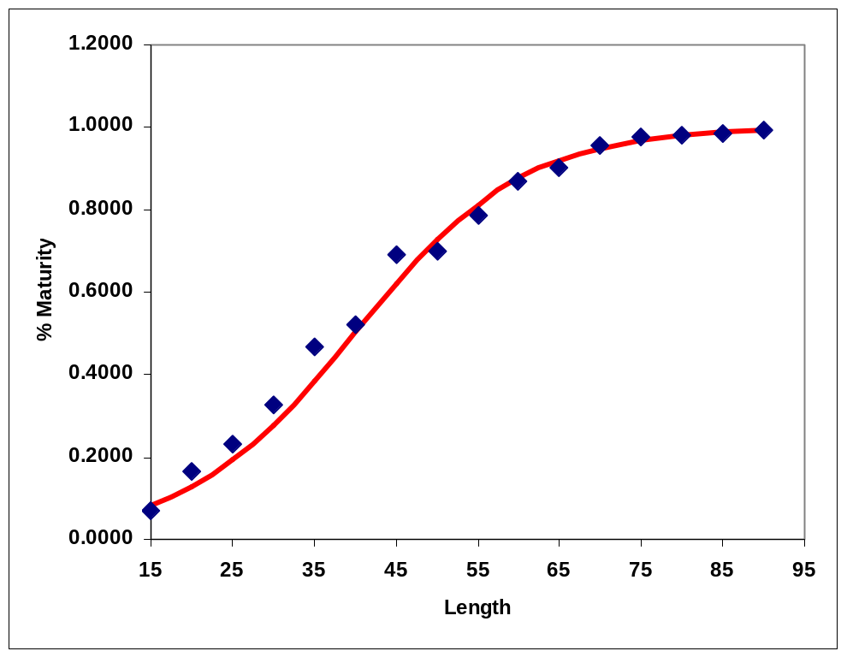
Example-A
Fit a logistic curve to maturity-at-length

Slide 13
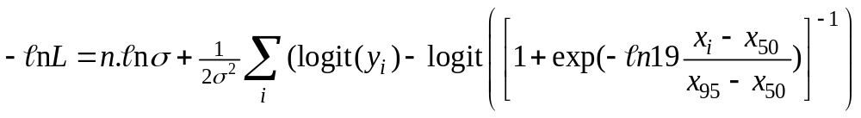
Example-A
The likelihood formulation of the problem.
The prior: uniform on x₅₀, x₉₅.
The jump function: multivariate normal.

Slide 14
Example-A
(Results-1)
sd <- c(0.1,0.1,0.1); cor <- matrix(c(1,0,0,0,1,0,0,0,1), ncol=3,nrow=3)

Slide 15
Example-A
(Results-2)
sd <- c(0.015702,0.0093949,0.17678);
cor <- matrix(c(1,0.3769,0,0.3769,1,0,0,0,1),ncol=3,nrow=3)

Slide 16
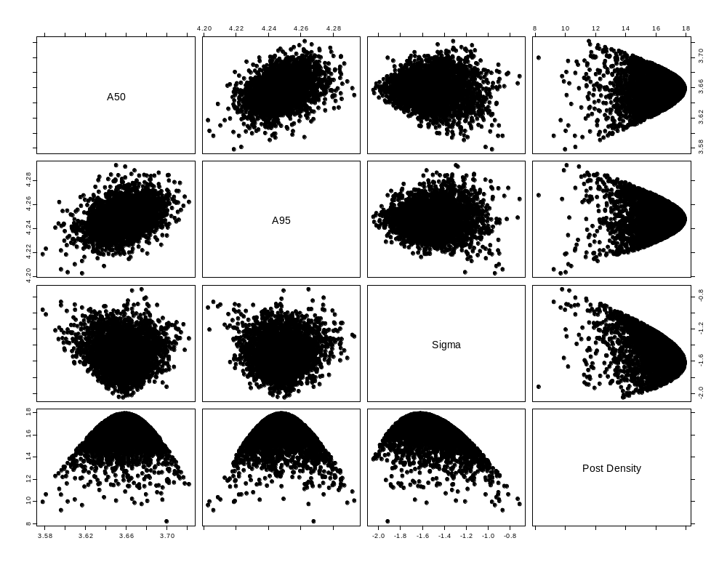
Example-A
(Posterior correlations)

Slide 17
Extensions
How would you include priors on the parameters of the model?
How would you add additional data (e.g. a survey index of abundance)?

Slide 18
“Burn in” and “thinning”
The impact of the initial parameter vector and the Markov nature of the algorithm are reduced by having a “burn in” period and by “thinning” the chain.
To get x samples from the posterior:
  Allow for a “burn-in” period (5-50% of the total chain length) to allow the algorithm to “set itself up”. The results of this period are discarded.
  “Thin” the chain by taking every n’th value in the chain.
Example: 2,500 samples, n=1,000, with a 10% “burn in” requires a total of 2,777,778 cycles!

Slide 19
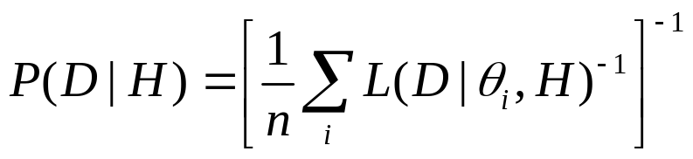
Model Selection
Model selection / model weighting can be achieved using DIC or Bayes Factor.
  The Bayes Factor needs to be estimated from the sample from the posterior distribution. Several formulae exist to estimate the Bayes Factor. The simplest, although among the most variable, is the harmonic mean of the likelihoods, i.e.:
  where n is the number of samples from the posterior.

Slide 20
Tricks of the (MCMC) trade - I
The performance of MCMC deteriorates as the number of parameters increases. Therefore, integrate out any nuisance parameters analytically.
  Examples (Walters and Ludwig, 1994).
    The catchability coefficients;
    The observation error standard deviations.
Walters, C.J. and D. Ludwig. Can. J. Fish. Aquat Sci. 51: 713-722

Slide 21
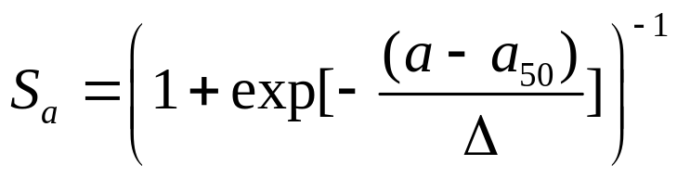
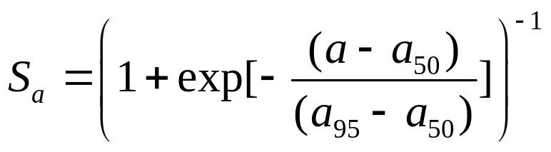
Tricks of the (MCMC) trade - II
MCMC deteriorates if the parameters are highly correlated (often true for age-structured models).
Examine the variance-covariance matrix to identify highly-correlated parameters (ρ ≥ 0.8).
Re-parameterize the model to reduce correlations:
Use
and not

Slide 22
Tricks of the (MCMC) trade - III
MCMC jumps may fall outside the allowable range if there are “hard” boundaries on the parameters. These can be avoided by:
  Working with logs rather than placing a “hard” boundary at 0.
  Working with the arctan of a variable to avoid placing two-sided bounds on parameters:
    For parameter x, defined on U[1,2], the transformation from y defined on U(-∞, ∞) to x is 1.5+arctan(y)/π

Slide 23
Tricks of the (MCMC) trade - IV
Always repeat the MCMC calculations for:
  different starting parameter vectors; and
  different random number seeds.

Slide 24
Advantages / Disadvantages
Advantages:
  Requires less coding than SIR (often only the likelihood*prior).
Disadvantages:
  Convergence testing is far more of an art than a science / some of the tests may be too refined / complicated for applied work.
  Run times can be extremely long.
  More options that require specification (“burn in” period, “thinning” rates, the choice of “jump” function).

Slide 25
Useful References
Gelman, A., Carlin, B.P., Stern, H.S. and Rubin, D.B. (1995) Bayesian Data Analysis. London: Chapman and Hall, 526 pp.
Punt, A.E. and Hilborn, R. (1997) Fisheries stock assessment and decision analysis: A review of the Bayesian approach. Rev. Fish. Biol. Fish. 7, 35-63.
Walters, C.[J.] and Ludwig, D. (1994) Calculation of Bayes posterior probability distributions for key population parameters. Can. J. Fish. Aquat. Sci. 51, 713-722.

